Slide 1

Unit-V
Local Models
Course In-Charges:
Dr.A.Mary Posonia
Dr.B.Ankayarkanni
SIT1305 Machine Learning

Slide 2
Unit-V
Competitive learning
Adaptive resonance theory
Self organizing map
Learning vector quantization
Assessing and Comparing Classification Algorithms
Combining Multiple Learners
Reinforcement Learning.
SIT1305 Machine Learning

Slide 3
Learning vector quantization(LVQ)
LVQ is a special case of an artificial neural network, it applies a winner-take-all Hebbian learning-based approach.
It is a predecessor to self-organizing maps (SOM) and related to neural gas, and to the k-nearest neighbor algorithm (k-NN). LVQ was invented by Teuvo Kohonen.
An LVQ system is represented by prototypes W = ( w ( i ) , . . . , w ( n ) ) which are defined in the feature space of observed data.
The winner-take-all training algorithms determines, for each data point, the prototype which is closest to the input according to a given distance measure.
The position of the winner prototype is then adapted, i.e. the winner is moved closer if it correctly classifies the data point or moved away if it classifies the data point incorrectly.
SIT1305 Machine Learning

Slide 4
An advantage of LVQ is that it creates prototypes that are easy to interpret for experts in the respective application domain.
LVQ systems can be applied to multi-class classification problems in a natural way.
It is used in a variety of practical applications.
A key issue in LVQ is the choice of an appropriate measure of distance or similarity for training and classification.
LVQ can be a source of great help in classifying text documents.(eg. Phonetic Typewriter)
SIT1305 Machine Learning

Slide 5
Algorithm
The algorithm consists of three basic steps. The algorithm's input is:
  how many neurons the system will have M (in the simplest case it is equal to the number of classes)
  what weight each neuron has w i for i = 0 , 1 , . . . , M − 1
  the corresponding label ci to each neuron wi
  how fast the neurons are learning η
  and an input list L containing all the vectors of which the labels are known already (training set).
SIT1305 Machine Learning

Slide 6
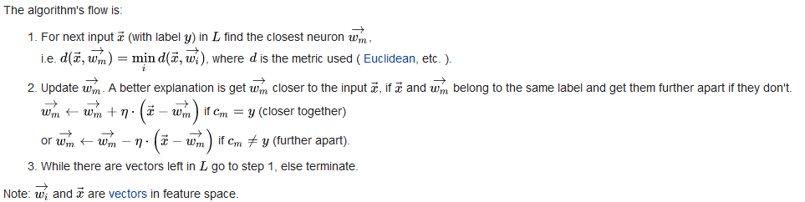
SIT1305 Machine Learning

Slide 7
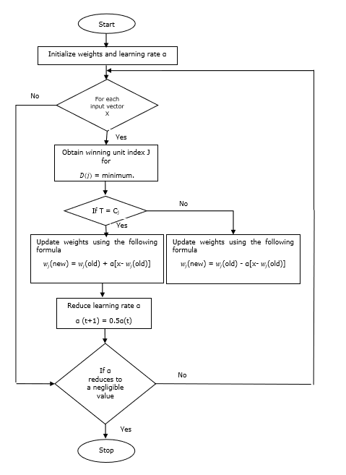
SIT1305 Machine Learning

Slide 8
Assessing and Comparing Classification Algorithms
Machine learning algorithms induce classifiers that depend on the training set, and there is a need for statistical testing to ,
  Assess the expected error rate of a classification algorithm and
  Compare the expected error rates of two classification algorithms to be able to say which one is better.
SIT1305 Machine Learning

Slide 9
  How can we assess the expected error rate of a classification algorithm on a problem?
  Given two classification algorithms, how can we say one has less error than the other one, for a given application?
    The classification algorithms compared can be different, for example, parametric versus nonparametric, or they can use different hyper parameter settings.
      Given a multilayer perceptron with four hidden units and another one with eight hidden units,
      With k-nearest neighbour classifier ,to find the best value of k.
      Training errors cannot be used to assess or compare two algorithms. Hence we need a validation set different from the training set.
SIT1305 Machine Learning

Slide 10
We compare classification algorithms by error rates.But error is only one of the criteria that affect our decision.Some other crtieria are:
  Risks when errors are generalized using loss functions.
  Training time and space complexity
  Testing time and space complexity
  Interpretability
  Easy programmability
SIT1305 Machine Learning

Slide 11
Cross-validation and Resampling methods
Need to get a number of training/validation set pairs from a dataset X.
If X is large randomly divide into K parts,then divide each part randomly into training and validation set.
K is typically 10 or 30 .
When dataset is small ,this is done by repeated use of the same data split differently,this is called cross-validation.
Cross-validation is a statistical method used to estimate the skill of machine learning models.
SIT1305 Machine Learning

Slide 12

1.K-fold Cross-Validation
The procedure has a single parameter called k that refers to the number of groups that a given data sample is to be split into.
The procedure is called k-fold cross-validation. When a specific value for k is chosen, it may be used in place of k in the reference to the model, such as k=10 becoming 10-fold cross-validation.
In K-Fold cross validation , the dataset X is divided randomly into K-equal sized parts Xi , i=1,2,...K.
To generate each pair, keep one of the K part out as the validation set and combine the remaining K-1 parts to form the training set.
SIT1305 Machine Learning
Notes:
Leave-one- out

Slide 13
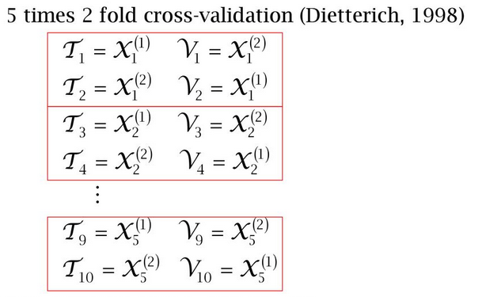
2.5x2 Cross-Validation
5x2 cross validation uses equal size of training and validation set.
Divide X randomly into two parts: X₁⁽¹⁾ and X₁⁽²⁾ which gives first pair of training and validation sets: T1= X₁⁽¹⁾ and V1= X₁⁽²⁾ .
Then swap the role of two halves and get the second pair T2= X₁⁽²⁾ and V2= X₁⁽¹⁾ .This is the first fold .
SIT1305 Machine Learning

Slide 14
3.Bootstrapping
To generate multiple samples from a single sample, an alternative to cross-validation is the bootstrap that generates new samples by drawing instances from the original sample with replacement.
The bootstrap samples may overlap more than cross-validation samples and hence their estimates are more dependent, but it is considered the best way for very small datasets.
SIT1305 Machine Learning

Slide 15
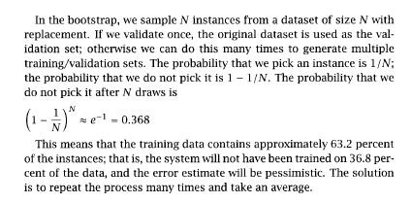
SIT1305 Machine Learning

Slide 16
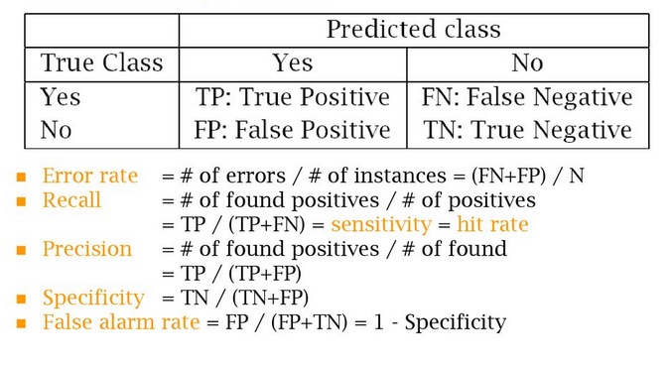
Measuring Error
When 0/1 loss is used, all errors are equally bad, and error calculations are based on the confusion matrix.
SIT1305 Machine Learning

Slide 17
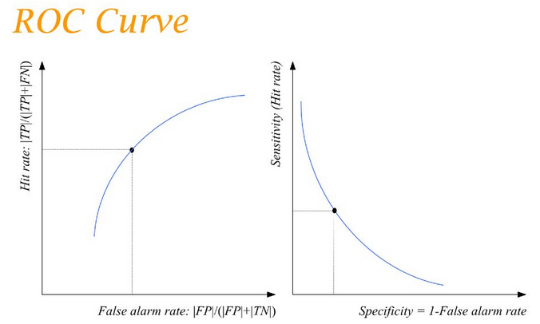
Receiver Operating Characteristics(ROC)
To fine-tune a classifier, draw a ROC curve which shows hit rate versus false alarm rate.
With each classification algorithm, there is a parameter ,eg. Threshold of decision, which can play with to change the number of TP versus FP.
SIT1305 Machine Learning

Slide 18
Hypothesis Testing
The process of hypothesis testing is to draw inferences or some conclusion about the overall population or data by conducting some statistical tests on a sample.
The same inferences are drawn for different machine learning models through T-test .
SIT1305 Machine Learning

Slide 19
Hypothesis Testing
For drawing some inferences, we have to make some assumptions that lead to two terms that are used in the hypothesis testing.
  Null hypothesis: It is regarding the assumption that there is no anomaly pattern or believing according to the assumption made.
  Alternate hypothesis: Contrary to the null hypothesis, it shows that observation is the result of real effect.
SIT1305 Machine Learning

Slide 20
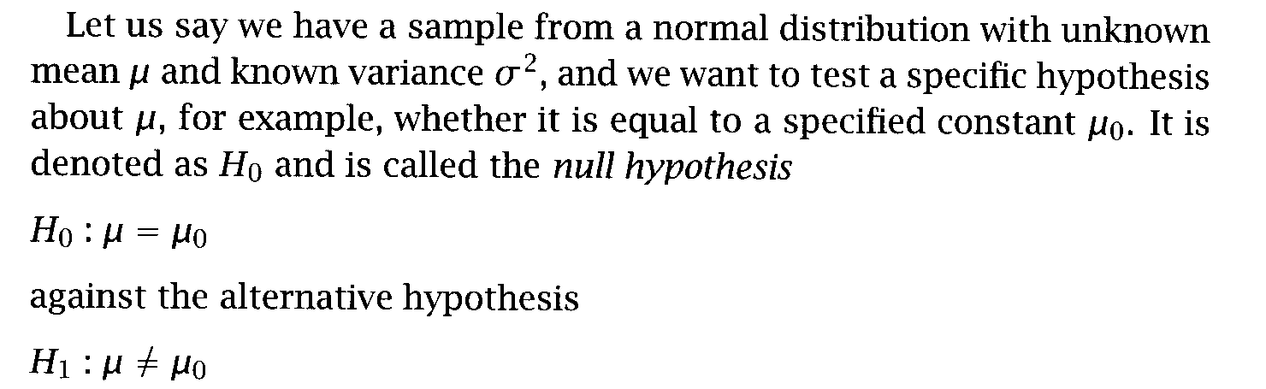
Hypothesis Testing
SIT1305 Machine Learning

Slide 21
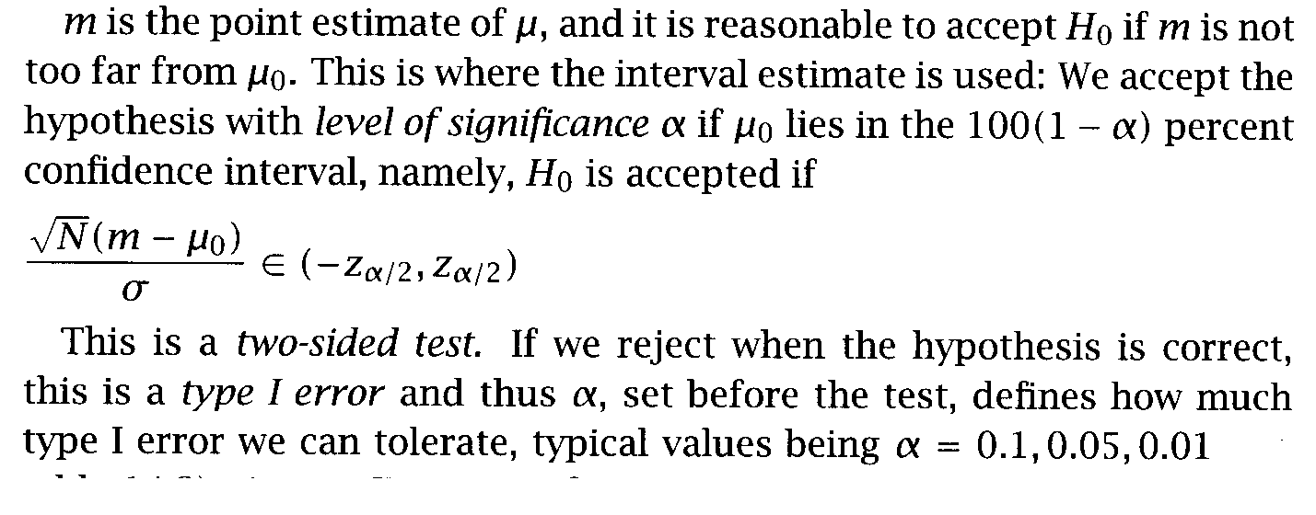
SIT1305 Machine Learning

Slide 22
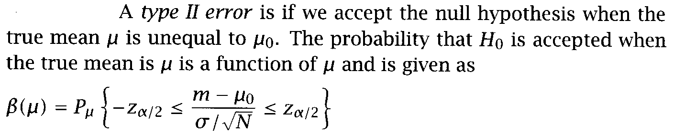
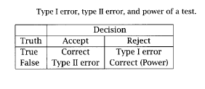

SIT1305 Machine Learning

Slide 23
Assessing a Classification Algorithms
Binomial test
Approximate Normal test
Paired t Test
SIT1305 Machine Learning

Slide 24
Comparing two Classification Algorithms
Given two learning algorithms and a training set, want to compare and test whether the two algorithms construct classifiers that have the same expected error rate on a new sample.
  McNemar’s Test
  K-Fold Cross-Validation Paired t Test
  5x2 cv paired t test
  5x2 cv paired F test
SIT1305 Machine Learning

Slide 25
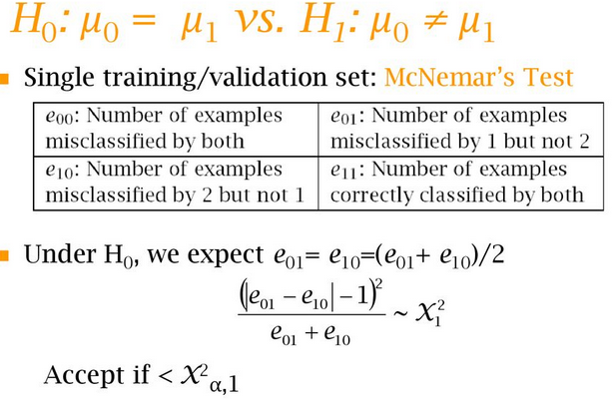
SIT1305 Machine Learning

Slide 26
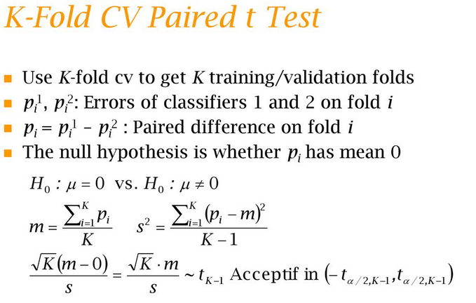
SIT1305 Machine Learning

Slide 27
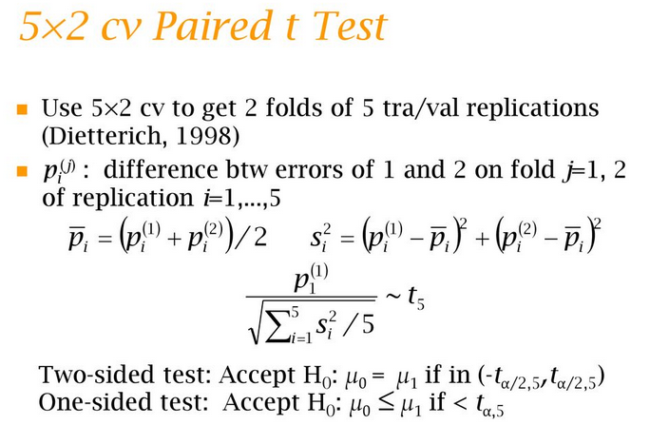
SIT1305 Machine Learning

Slide 28
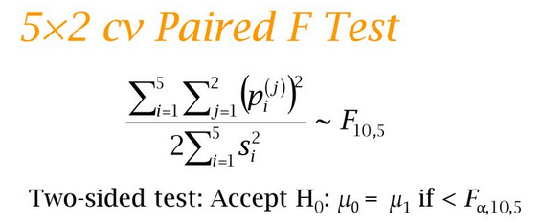
SIT1305 Machine Learning

Slide 29
Combining Multiple Learners
Ensemble learning is a machine learning paradigm where multiple models (often called “weak learners”) are trained to solve the same problem and combined to get better results.
The main hypothesis is that when weak models are correctly combined we can obtain more accurate and/or robust models.
SIT1305 Machine Learning

Slide 30
How to combine these models. Three major kinds of meta-algorithms that aims at combining weak learners:
  bagging, considers homogeneous weak learners, learns them independently from each other in parallel and combines them following some kind of deterministic averaging process.
  boosting, considers homogeneous weak learners, learns them sequentially in a very adaptative way (a base model depends on the previous ones) and combines them following a deterministic strategy.
  stacking, considers heterogeneous weak learners, learns them in parallel and combines them by training a meta-model to output a prediction based on the different weak models predictions.
SIT1305 Machine Learning

